Slide 1
Module 4
UI Development & Agent Integration

Slide 2
User Interface Design -Requirements
Designing the Frontend UI
Crafted wireframes for a clean, intuitive dashboard
Components: Search input, API key option, Static Stock info,
Focused on responsive design for desktop, tablet, and mobile
Implementing UI with Streamlit
Built dynamic UI using Streamlit components
Integrated: Forms, dropdowns, password fields and results panels
Ensured real-time updates with loading indicators and status feedback
Handled agent-triggered backend workflows seamlessly

Slide 3
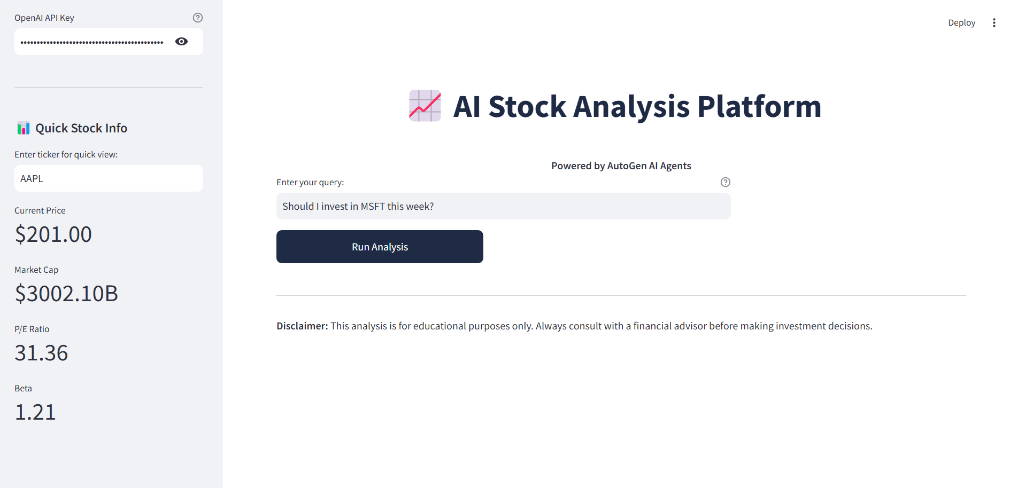
User Interface Design

